Slide 1

6th Grade Accelerated Math
Unit 14, Lesson 5 Writing and Solving One-Step Addition and Subtraction Equations Within Real-World Contexts Volume 2, pg. 361

Slide 2


Benchmark
MA.6.AR.2.2
Write and solve one-step equations in one variable within a mathematical or real-world context using addition and subtraction, where all terms and solutions are integers.
volume 2, pg. 361

Slide 3
Integrated Mathematical Thinking and Reasoning Standards
MA.K12.MTR.1.1 Actively participate in effortful learning both individually and collectively.
MA.K12.MTR.2.1 Demonstrate understanding by representing problems in multiple ways.
MA.K12.MTR.4.1 Engage in discussions that reflect on the mathematical thinking of self and others.
MA.K12.MTR.5.1 Use patterns and structure to help understand and connect mathematical concepts.
MA.K12.MTR.6.1 Assess the reasonableness of solutions.
MA.K12.MTR.7.1 Apply mathematics to real-world contexts.
volume 2, pg. 361

Slide 4

Learning Target
I can write and solve one-step equations in one variable within a real-world context using addition and subtraction.
volume 2, pg. 361

Slide 5

Warm-Up
volume 2, pg. 361

Slide 6
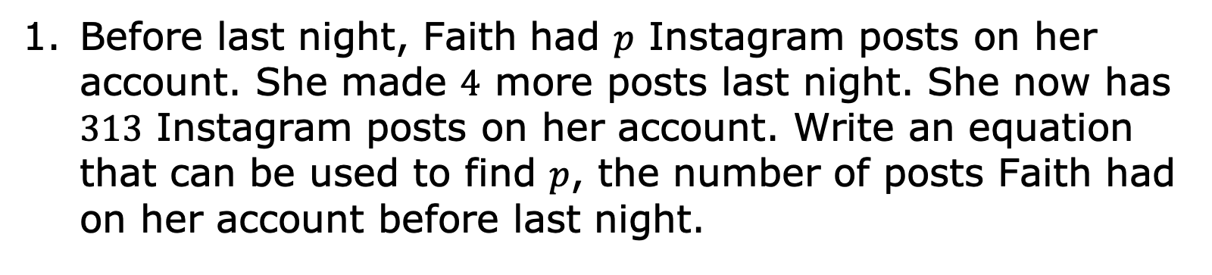
14.5.1 Warm-Up: Bell Work
Before last night, Faith had $p$ Instagram posts on her account. She made $4$ more posts last night. She now has $313$ Instagram posts on her account. Write an equation that can be used to find $p$, the number of posts Faith had on her account before last night.
volume 2, pg. 361

Slide 7

Collaboration
volume 2, pg. 362

Slide 8

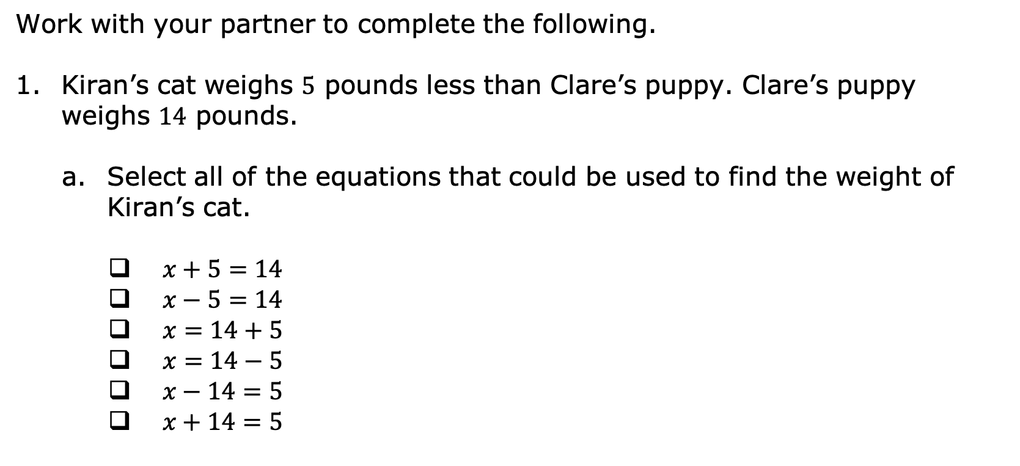
14.5.2 Collaboration: Solving Equations in Real-World Contexts
Work with your partner to complete the following.
Kiran’s cat weighs $5$ pounds less than Clare’s puppy. Clare’s puppy weighs $14$ pounds.
Select all of the equations that could be used to find the weight of Kiran’s cat.
$x+5=14$
$x−5=14$
$x=14+5$
$x=14−5$
$x−14=5$
$x+14=5$
volume 2, pg. 362

Slide 9
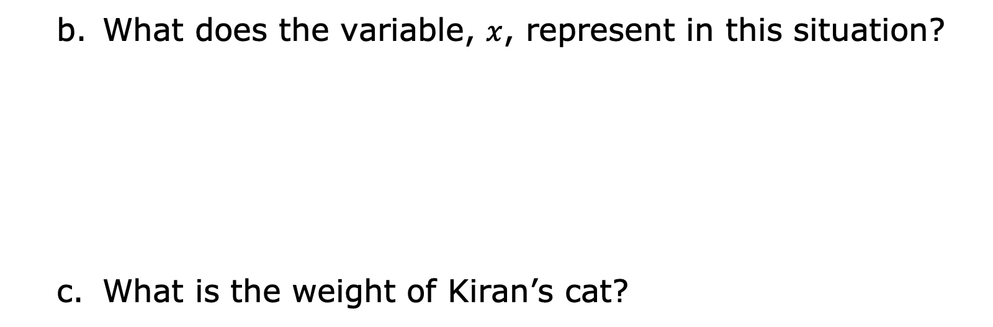
What does the variable, $x$, represent in this situation?
What is the weight of Kiran’s cat?
volume 2, pg. 362

Slide 10
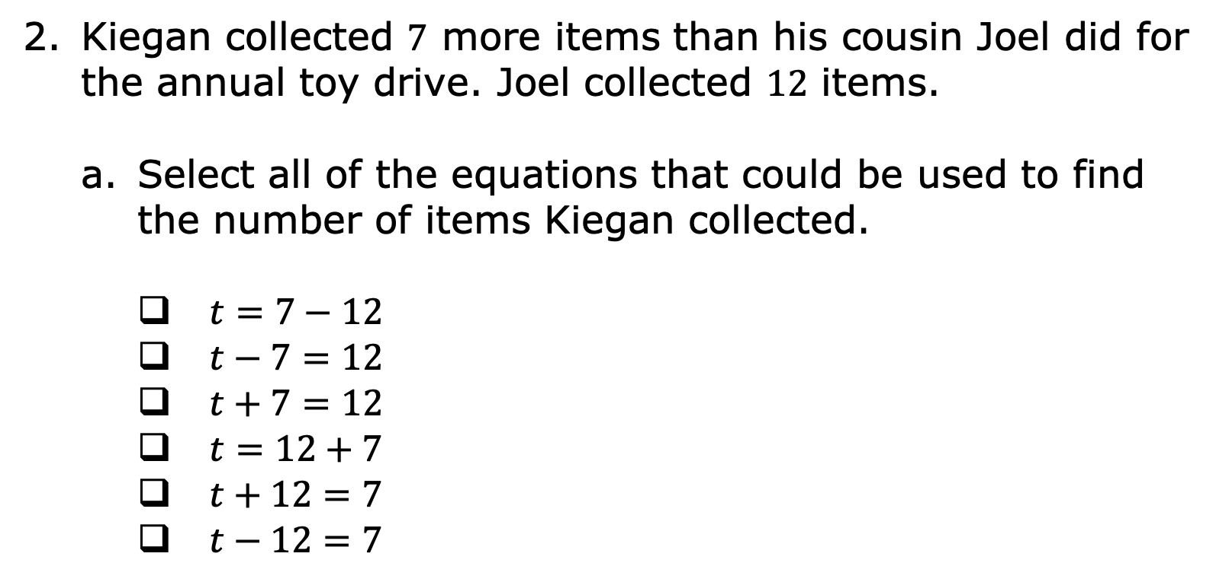
Kiegan collected $7$ more items than his cousin Joel did for the annual toy drive. Joel collected $12$ items.
Select all of the equations that could be used to find the number of items Kiegan collected.
$t=7−12$
$t−7=12$
$t+7=12$
$t=12+7$
$t+12=7$
$t−12=7$
volume 2, pg. 362

Slide 11
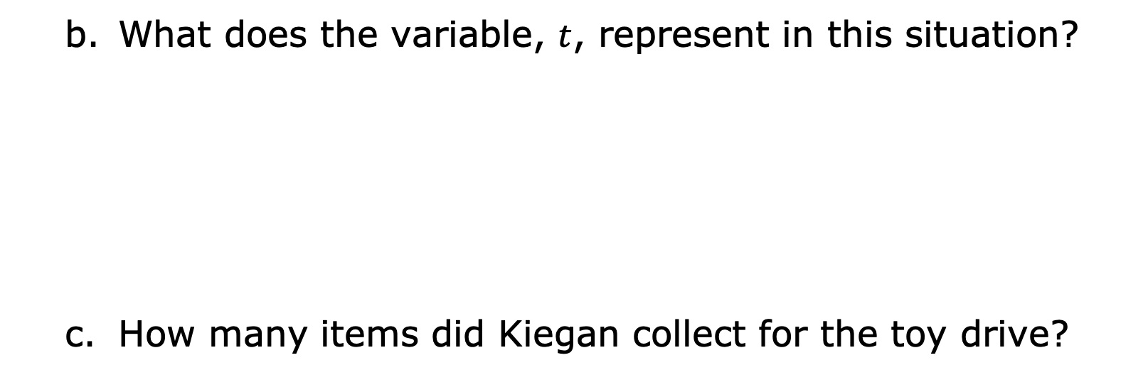
What does the variable, $t$, represent in this situation?
How many items did Kiegan collect for the toy drive?
volume 2, pg. 362

Slide 12
Discuss with your partner what you notice about the equations that represent the two situations. Summarize your discussion.
volume 2, pg. 362

Slide 13

Guided Practice
volume 2, pg. 363

Slide 14

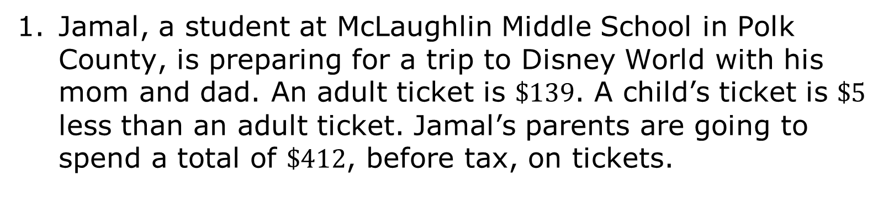
14.5.3 Guided Practice: Writing and Solving Real-World Equations to Find a Value
Jamal, a student at McLaughlin Middle School in Polk County, is preparing for a trip to Disney World with his mom and dad. An adult ticket is $\$139$. A child’s ticket is $\$5$ less than an adult ticket. Jamal’s parents are going to spend a total of $\$412$, before tax, on tickets.
volume 2, pg. 363

Slide 15
Write an algebraic equation to represent the relationship between the cost of a child’s ticket and the cost of an adult ticket in this situation.
What does the variable in your equation represent?
volume 2, pg. 363

Slide 16
Solve the equation.
What was the cost of Jamal’s ticket?
volume 2, pg. 363

Slide 17
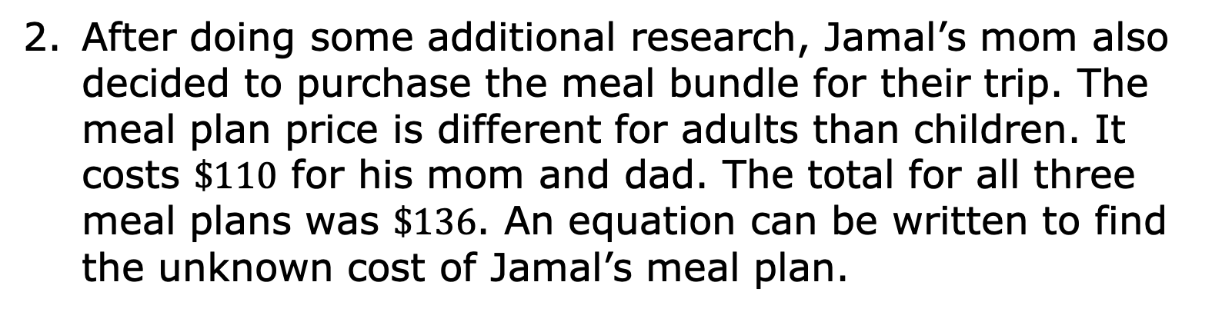
After doing some additional research, Jamal’s mom also decided to purchase the meal bundle for their trip. The meal plan price is different for adults than children. It costs $\$110$ for his mom and dad. The total for all three meal plans was $\$136$. An equation can be written to find the unknown cost of Jamal’s meal plan.
volume 2, pg. 363

Slide 18
Write an algebraic equation that can be used to find the cost of Jamal’s meal plan.
What does the variable in your equation represent?
volume 2, pg. 363

Slide 19
Solve the equation.
How much was Jamal’s meal plan?
volume 2, pg. 363

Slide 20
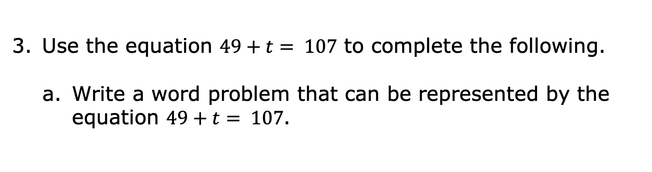
Use the equation $49+t= 107$ to complete the following.
Write a word problem that can be represented by the equation $49+t= 107$.
volume 2, pg. 364

Slide 21
What does the variable represent based on the word problem you created?
What is the value of the variable?
volume 2, pg. 364

Slide 22
Share only your word problem with your partner. Use your partner’s word problem to fill in the table.
Partner’s Word Problem | What Does the Variable Represent? | Solve the Equation | Partner’s Initials
volume 2, pg. 364

Slide 23
Collaboration
volume 2, pg. 364

Slide 24
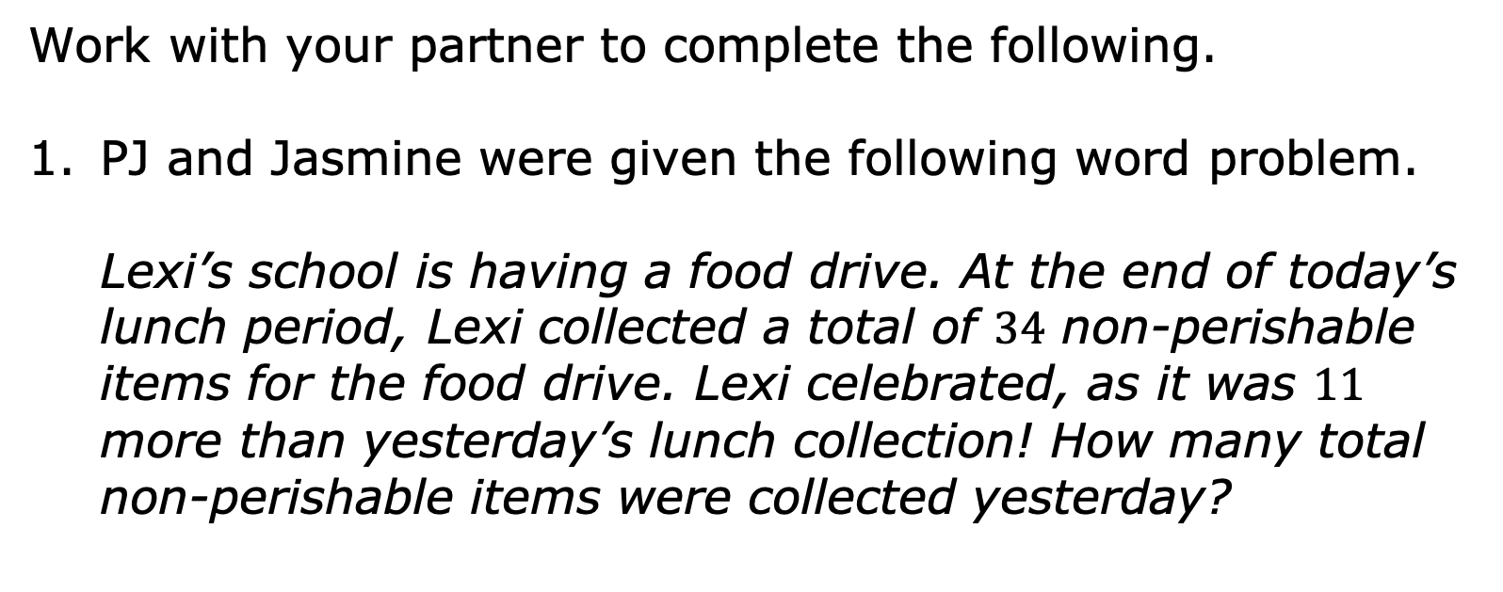
14.5.4 Collaboration: Writing and Solving Equations for Real-World Contexts
Work with your partner to complete the following.
PJ and Jasmine were given the following word problem.
Lexi’s school is having a food drive. At the end of today’s lunch period, Lexi collected a total of $34$ non-perishable items for the food drive. Lexi celebrated, as it was $11$ more than yesterday’s lunch collection! How many total non-perishable items were collected yesterday?
volume 2, pg. 364

Slide 25
Jasmine told PJ they needed to solve the problem using an addition equation. PJ disagreed and said they need to use a subtraction equation.
With your partner, determine who will follow Jasmine’s suggestion and who will follow PJ’s. Then, write the equation based on whose suggestion you are assigned and solve.
Jasmine’s Suggestion “Addition” | PJ’s Suggestion “Subtraction”
volume 2, pg. 364

Slide 26
Compare your equations and discuss your solutions with your partner.
Explain who was correct in their initial suggestion – Jasmine, PJ, both of them, or neither of them.
How many non-perishable food items were collected during Lexi’s lunch period yesterday?
volume 2, pg. 365

Slide 27

An image of two swimmers in a pool is shown.
Work with your partner to create an addition or subtraction word problem based on the image.
volume 2, pg. 365

Slide 28
Write an equation to represent your scenario.
What does the variable represent in your equation represent?
What is the value of the variable?
volume 2, pg. 365

Slide 29

Your Turn
volume 2, pg. 366

Slide 30
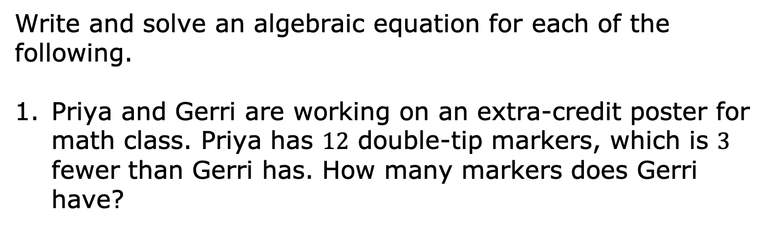
14.5.5 Your Turn!
Write and solve an algebraic equation for each of the following.
Priya and Gerri are working on an extra-credit poster for math class. Priya has $12$ double-tip markers, which is $3$ fewer than Gerri has. How many markers does Gerri have?
volume 2, pg. 366

Slide 31
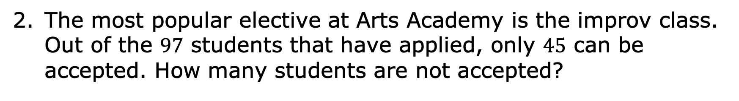
The most popular elective at Arts Academy is the improv class. Out of the $97$ students that have applied, only $45$ can be accepted. How many students are not accepted?
volume 2, pg. 366

Slide 32

Wrap-Up
volume 2, pg. 366

Slide 33
14.5.6 Wrap-Up: Reflection
Shade in the arrow up to the statement that best describes your current understanding of the benchmark below:
Write and solve one-step equations in one variable within a mathematical or real-world context using addition and subtraction, where all terms and solutions are integers.
 | I’m so confident, I could explain how to write and solve one-step equations in one variable using addition or subtraction to someone else!
 | I can get to the right answer, but I don’t understand well enough to explain how to write and solve one-step equations in one variable yet.
 | I understand some of this, but I don’t understand all of it yet.
 | I have been trying hard, but I am finding this challenging.
volume 2, pg. 366

